Slide 1
Software engineering (Undergraduate)
Chapter 2 software quality
Course Name software quality and testing
CSC 4133
(Undergraduate)

Slide 2
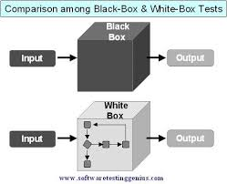
quality perspectives
Chapter 2: Software Quality
Chapter 2: Software Quality
S.2
S.2
MMH
Subject of SQAT: People’s perspectives
External/Consumer: customers and users
Internal/Producer: developer, testers, and managers
Other: 3rd party, indirect users (email notification)
Objects of SQAT:
Software products, systems, and services
External View
mostly sees a software system as a black box, where one can observe its behavior but not see through inside
Internal View
mostly sees a software system as a white box, or more appropriately a clear box, where one can see what is inside and how it works

Slide 3

Views in software quality (Kitchenham and Pfleeger)
Chapter 2: Software Quality
S.3
MMH
1. Mystical view (misconception)
Quality is something that can be recognized through experience, but not defined in some tractable form
A good quality object stands out, and it is easily recognized
2. User view
Quality concerns the extent to which a product meets user needs and expectations
A product is of good quality if it satisfies a large number of users
It is useful to identify the product attributes which the users consider to be important
This view may encompass many subject elements, e.g. usability, reliability, efficiency, etc.

Slide 4

Views in software quality
Chapter 2: Software Quality
S.4
MMH
3. Manufacturing view
Conformance to process standards/requirements
Quality is seen as conforming to requirements leads to consistency in products
Any deviation from the requirements is seen as reducing the quality of the product
Products are manufactured “right the first time” so that the cost can be reduced (very low changing possibility and without re-work)
Product quality can be incrementally improved by improving the process
The CMM and ISO 9001 models are based on the manufacturing view

Slide 5

Views in software quality
Chapter 2: Software Quality
S.5
MMH
4. Product view
If a product is manufactured with good internal properties, then it will have good external properties
5. Value-based view
Customers’ willingness to pay for a software
Value-based view represents the merger of two concepts: excellence and worth
Quality is a measure of excellence, and value is a measure of worth
The value-based view makes a trade-off between cost and quality

Slide 6
Why measure quality?
Chapter 2: Software Quality
S.6
MMH
Measurement allows us to have a quantitative view of the quality concept
What are the reasons for developing a quantitative view of quality?
Baseline:
Measurement allows us to establish baselines for qualities to achieve (Usability- extract all the information within 20 minutes from a website)
Quality improvement based on cost:
Organizations make continuous improvements in their process models and an improvement has a cost associated with it. Measurement is key to process improvement
Know the present level for future planning:
The needs for improvements can be investigated after performing measurements

Slide 7
Software quality Factor
Chapter 2: Software Quality
S.7
MMH
Software Quality in terms of quality factors and quality criteria
McCall’s Quality Factors and Criteria
Quality Factors
A quality factor represents the behavioral characteristic of a system
Examples
Correctness
Reliability
Efficiency
Performance

Slide 8


Software quality factor
Chapter 2: Software Quality
S.8
MMH
EFFICIENCY
The amount of computing resources and code required by program to perform a function (e.g. multi-tasking)
At least 25 percent of the processor capacity and RAM available to the application shall be unused at the planned peak load conditions.
INTEGRITY / SECURITY
The extend to which access to a software or data by unauthorized persons can be controlled.
CHOICE POINT security issue of unprotected data on a tape
Only users who have Auditor access privileges shall be able to view customer transaction histories.

Slide 9

Software quality factor
Chapter 2: Software Quality
S.9
MMH
USABILITY
The effort required to learn, operate, prepare input, and interpret output of a program
Time required (e.g. 30 minutes maximum) to extract information regarding higher studies application in Sweden from the website http://studera.nu
A trained user shall be able to submit a complete request for a chemical selected from a vendor catalog in an average of four and a maximum of six minutes.

Slide 10
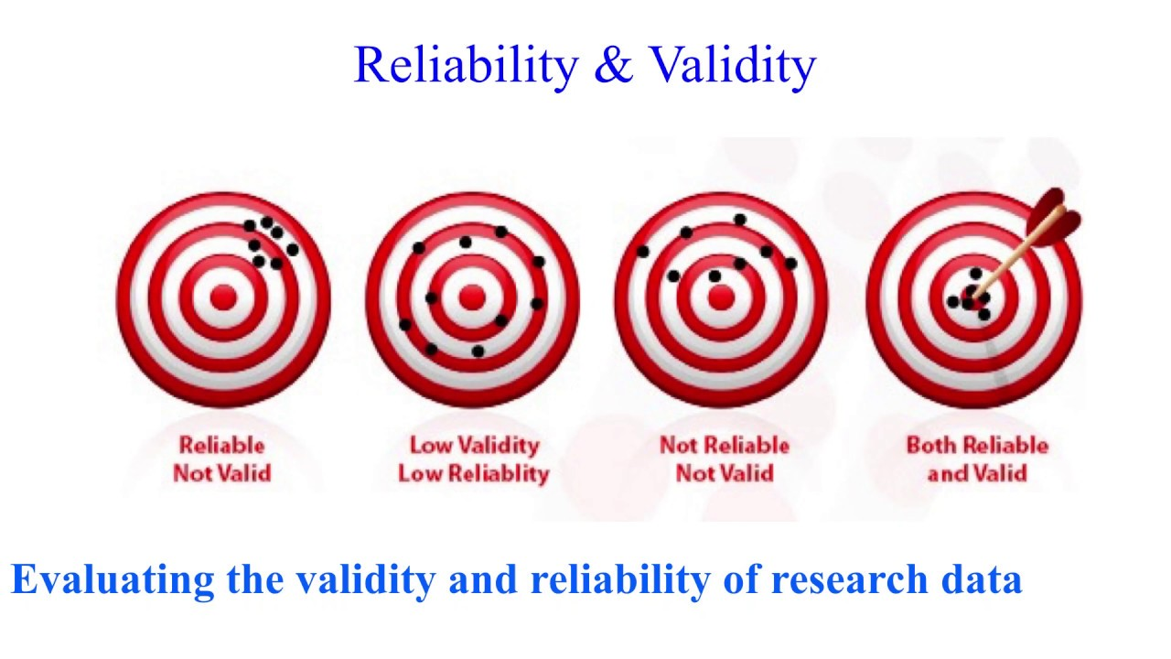

Software quality factor
Chapter 2: Software Quality
S.10
MMH
RELIABILITY AND CORRECTNESS
The extend to which a program can be expected to perform its intendent functions with required precession (user’s objectives/satisfaction).
The probability of the software executing without failure for a specific period of time is known as reliability
Example: No more than five experimental runs out of 1000 can be lost because of software failures

Slide 11

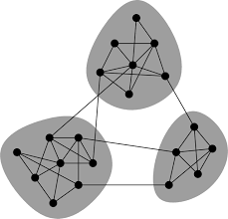
Chapter 2: Software Quality
S.11
MMH
Software quality criteria
Software Quality Criteria
A quality criterion is an attribute of a quality factor that is related to software development
Example: Modularity, testability, maintainability, reusability, etc.
MODULARITY
Modularity is an attribute of the architecture of a software system
A highly modular software allows designers to put cohesive components in one module, thereby increasing the maintainability of the system
Compatibility among the module integration

Slide 12

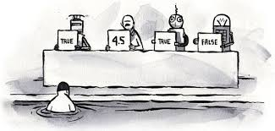

Software quality criteria
Chapter 2: Software Quality
S.12
MMH
MAINTAINABILITY
The effort required to locate and fix a defect in an operational program
A maintenance programmer shall be able to modify existing reports to conform to revised chemical-reporting regulations from the federal government with 20 labor hours or less of development effort.
TESTABILITY
The effort required to program to ensure that it performs its intendent functions.
The maximum cyclomatic complexity* of a module shall not exceed 20
FLEXIBILITY
The effort required to modify an operational program.
A maintenance programmer who has at least six months of experience supporting this product shall be able to make a new copy output available to the product, including code modifications and testing, with no more than one hour of labor.

Slide 13




Software quality criteria
Chapter 2: Software Quality
S.13
MMH
PORTABILITY
The effort required to transfer a program from one hardware and/or software environment to another
REUSABILITY
The extend to which parts of a software system can be reused in other application
The chemical structure input functions shall be designed to be reusable at the object code level in other applications that use the international standard chemical structure representations.
INTEROPERABILITY
The effort required to couple one system with another (Biometric SIM registration, Blockchain)
The Chemical Tracking System shall be able to import any valid chemical structure from the ChemiDraw (version 2.3 or earlier) and Chem-Struct (version 5 or earlier) tools.

Slide 14
ISO-9126 Quality Framework
Chapter 2: Software Quality
S.14
MMH
ISO (International Organization for Standardization)
Quality characteristics
Functionality: what is needed
Reliability: functions correctly
Usability: effort to use
Efficiency: resource needed
Maintainability: correct/improve/adapt
Portability: from one environment to another
ISO-9126:
The mostly influential one in the software engineering community today
Provides a hierarchical framework for quality definition, organized into quality characteristics and sub-characteristics
Six top-level quality characteristics, each associated with its own exclusive (non-overlapping) sub-characteristics

Slide 15
quality expectations
Chapter 2: Software Quality
S.15
MMH
External/Consumer expectations
“good enough” for the PRICE
Fit-for-use: doing the “right things”
Conformance: doing the “things right”
Expectations for different software
General: functionality & reliability
Usability: GUI/end-user/web/etc.
Safety: safety-critical systems (autopilot)
Internal/Producer expectations
“good enough” for the COST
Mirror consumer side
Functionality & correctness via V&V
Service related: maintainability
Interfacing units: interoperability
3rd party: modularity (outsource)

Slide 16
references
Chapter 2: Software Quality
S.16
MMH
Software Testing And Quality Assurance – Theory and Practice - Kshirasagar Naik & Priyadarshi Tripathy
Software Quality Engineering: Testing, Quality Assurance and Quantifiable Improvement - Jeff Tian

